Slide 1
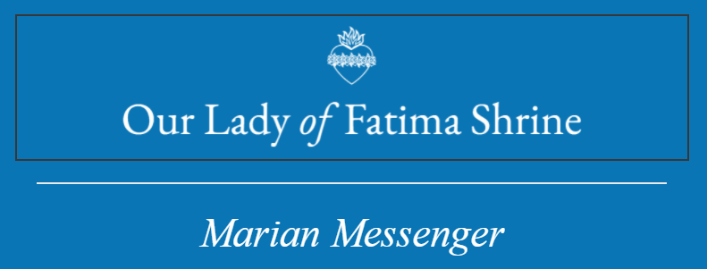
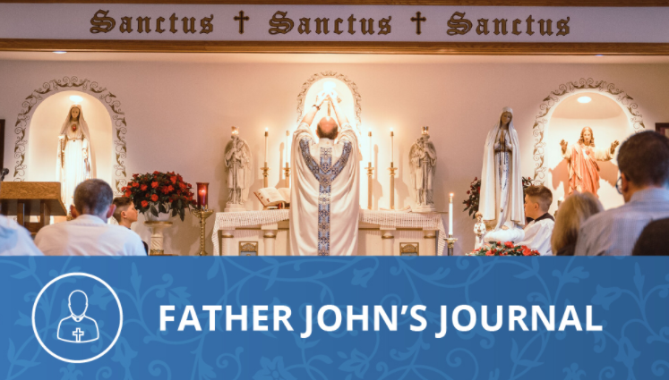
What Happened on
May 13 – June 13 – July 13, 1917?
2nd Quarter
May 2023
Beginning on May 13 and continuing until October 13, we re-live the apparitions of the Blessed Virgin Mary to the Servant of
Join Us for Mass
Special Masses of the Apparitions at 5:00 pm:
Friday, May 12th
Tuesday, June 13th
Thursday, July 13th
First Friday Masses at 5:00 pm: May 5th
June 2nd
July 7th
First Saturday Masses at 8:00 am: May 6th
June 3rd
July 7th
Rosary and Confessions
30 minutes before First Friday and Saturday Masses.
God, Lucia dos Santos and her little cousins, Saints Jacinta and Francisco Marto. Lucia was ten years old, Francisco was nine, and Jacinta only seven. Francisco could see the Lady but could not hear her. Jacinta could both see and hear the Lady, but Jacinta did not talk to her. All conversations, during the apparitions, were between the Blessed Mother and Lucia.
What took place on May 13th? Having eaten their lunch and reciting the rosary, as was their custom, they settled down to building little stone houses. Suddenly a brilliant shaft of light pierced the sky, and thunder frightened them into gathering the sheep and starting down the hill to go home. A second shaft of light caused them to turn toward the right, and the, standing above a small holm oak they saw a beautiful Lady.
Lucia, in her own words, described the vision: “It was a Lady dressed all in white, more brilliant than the sun; shedding rays of light, clearer and stronger than a crystal glass filled with the most sparkling water, pierced by the burning rays of the sun”.
We can almost see what the children saw! A brilliant Lady with hands folded in prayer, a rosary of white pearls ending in a crucifix of burnished silver hanging from her arm; her feet bare and resting on a cloud that barely touched the holm oak. But the dialogue that day contains tremendous lessons:
“Do not be afraid,” the Lady said in a sweet voice, “I will not harm you.” Lucia asked: “Where are you from, Madam?” “I am from heaven.” “What do you wish from me?” “I come to ask you to meet me here six months in succession at this same hour, on the thirteenth of each month. In October, I will tell you who I am and what I want.” Lucia then asked: “Am I going to heaven?” “Yes, you shall.” “And Jacinta?” “She too.” “And Francisco?” “He too, but first he must say many Rosaries.” (Our Lady looked upon Francisco with a beautiful and compassionate glance. But, somewhere in his little heart the Lady saw a fault that others could not see.)
Lucia thought of two girls in the village who had recently died. She asked our Lady: “Is Maria Nevers in heaven?” “Yes, she is.” “And Amelia?” “She will be in purgatory till the end of the world.”

Slide 2
Many of us may object to this revelation of an eighteen-year-old girl who died in a remote village in 1917, having to suffer for so long in Purgatory. But Lucia saw nothing strange about it especially if a person can go to hell for all eternity for missing Mass on Sunday. Then the Lady said to the children:
“Do you wish to offer yourselves to God to endure all the sufferings that he may choose to send you, as an act of reparation for the sins by which He is offended, and to ask for the conversion of sinners?” “Yes we do!” Lucia answered eagerly. “Then you will have much to suffer, but the grace of God will assist you and always bear you up.”
Mary then opened her hands (as on the Miraculous Medal). From each palm came a stream of light which shone on the children and seemed to penetrate to the depths of their souls. Moved by an impulse, the children fell to their knees and prayed: “Most Holy Trinity, I adore You? My God, my God, I love you in the Most Blessed Sacrament.” The Lady spoke again, “Say the Rosary every day to obtain peace for the world and the end of the war.” “She began to elevate herself serenely,” Lucia say’s, “going in the direction of the east until she disappeared in the immensity of space.”
This first apparition teaches us to take sin seriously in the light of Our Lady’s words concerning Francisco and Amelia. Mary wants us to return on June 13 at noon to hear her message. She wants us to offer our sufferings in reparation for sin; and to pray the Rosary every day.
What took place on June 13th?
The Lady told the children to “say the Rosary always.” To Lucia she said, “I want you to learn to read. Then I will tell you what else I want.” When Lucia asked that the three of them be taken to heaven, our Lady said, “I will take Jacinta and Francisco soon, but you must remain longer here below. Jesus will use you to make me better known and more loved. He wishes to establish throughout the world devotion to my Immaculate Heart. I promise salvation to those who embrace it and their souls will be loved by God as flowers placed by myself to adorn His thrown.” “Then I am to stay here alone!” Lucia said, sad at the thought of losing her cousins and being left behind. “No my child. You are suffering very much, but do not be discouraged. I will never leave you. My Immaculate Heart will be your refuge and the way that will lead you to God.”
Mary parted her hands again, and the children were enveloped by the light from her palms. Francisco and Jacinta were in a stream that went to heaven, and Lucia was in a stream that spread over the ground. A heart surrounded by thorns was in from of the right palm. “We understand,” says Lucia, “that this was the Immaculate Heart of Mary, so offended by the sins of mankind, desiring reparation.
The lessons of June 13th teach us to live in the Divine Will; to desire what God desires, to love what God loves. God desires devotion to the Immaculate Heart of Mary to be established in the world. Our mission is the same as Lucia’s. We need not be afraid because the Immaculate Heart of Mary will lead us to God!
“O Jesus, it is for Your love, for the conversion of sinners, and in reparation for sins committed against the Immaculate Heart of Mary.”
As our Lady said these words, she parted her hands. The light from he palms penetrated the earth. The children saw a great sea of fire. “In this sea”, says Lucia, “were immersed black and burning demons and souls in human forms, resembling live transparent coals. Lifted up into the air by the flames, they fell back on all sides like sparks in a conflagration, with neither weight nor balance, amid loud screams and cries of pain and despair which horrified us and shook us with terror. We could tell the devils by their horrible and nauseous figures of hateful and unknown animals, but transparent as the black coals in the fire.”
The children, pale with terror, raised their eyes to our Lady for help. “You have seen hell where the souls of poor sinners go. To save them, our Lord wishes to establish throughout the world
18637 Ray Street, Riverview, MI 48193 bluearmy18637@gmail.com
734.281.1445 1st Quarter, February 2023

Slide 3
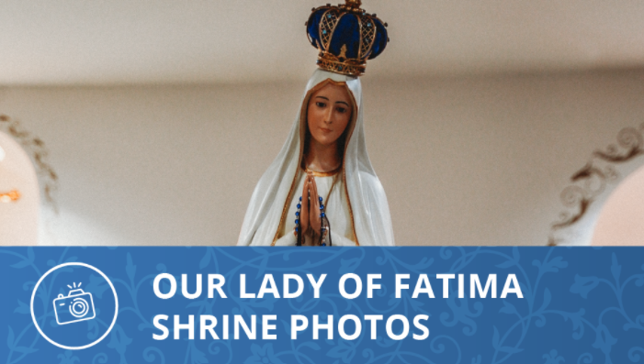
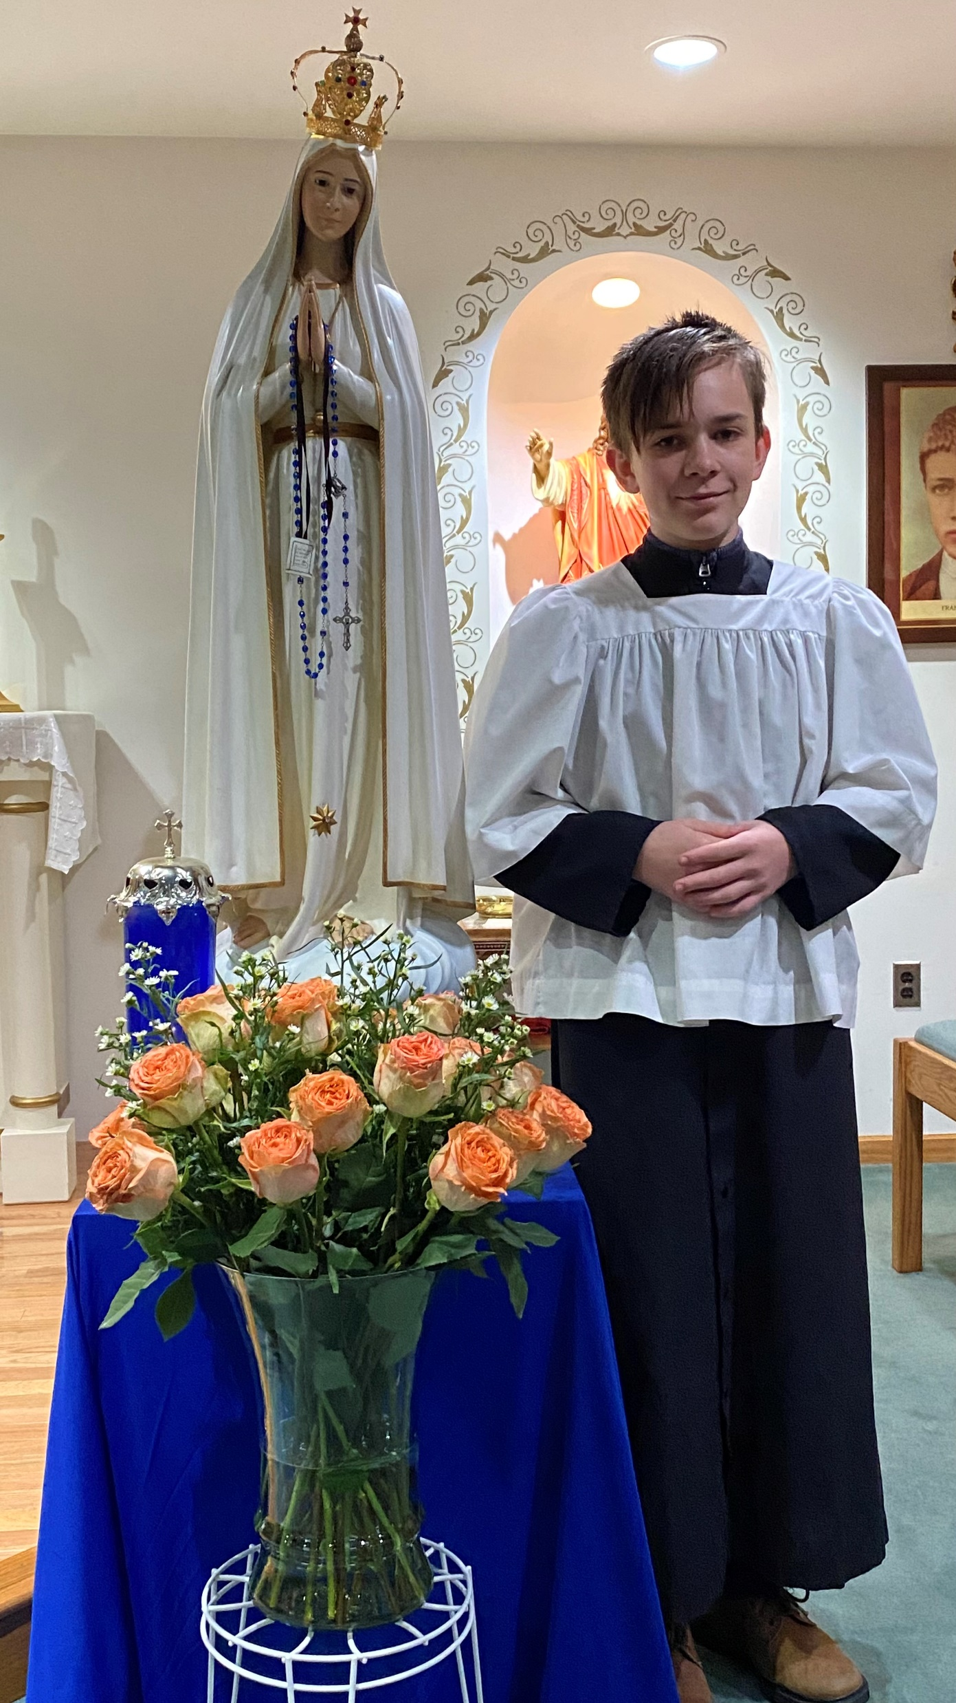
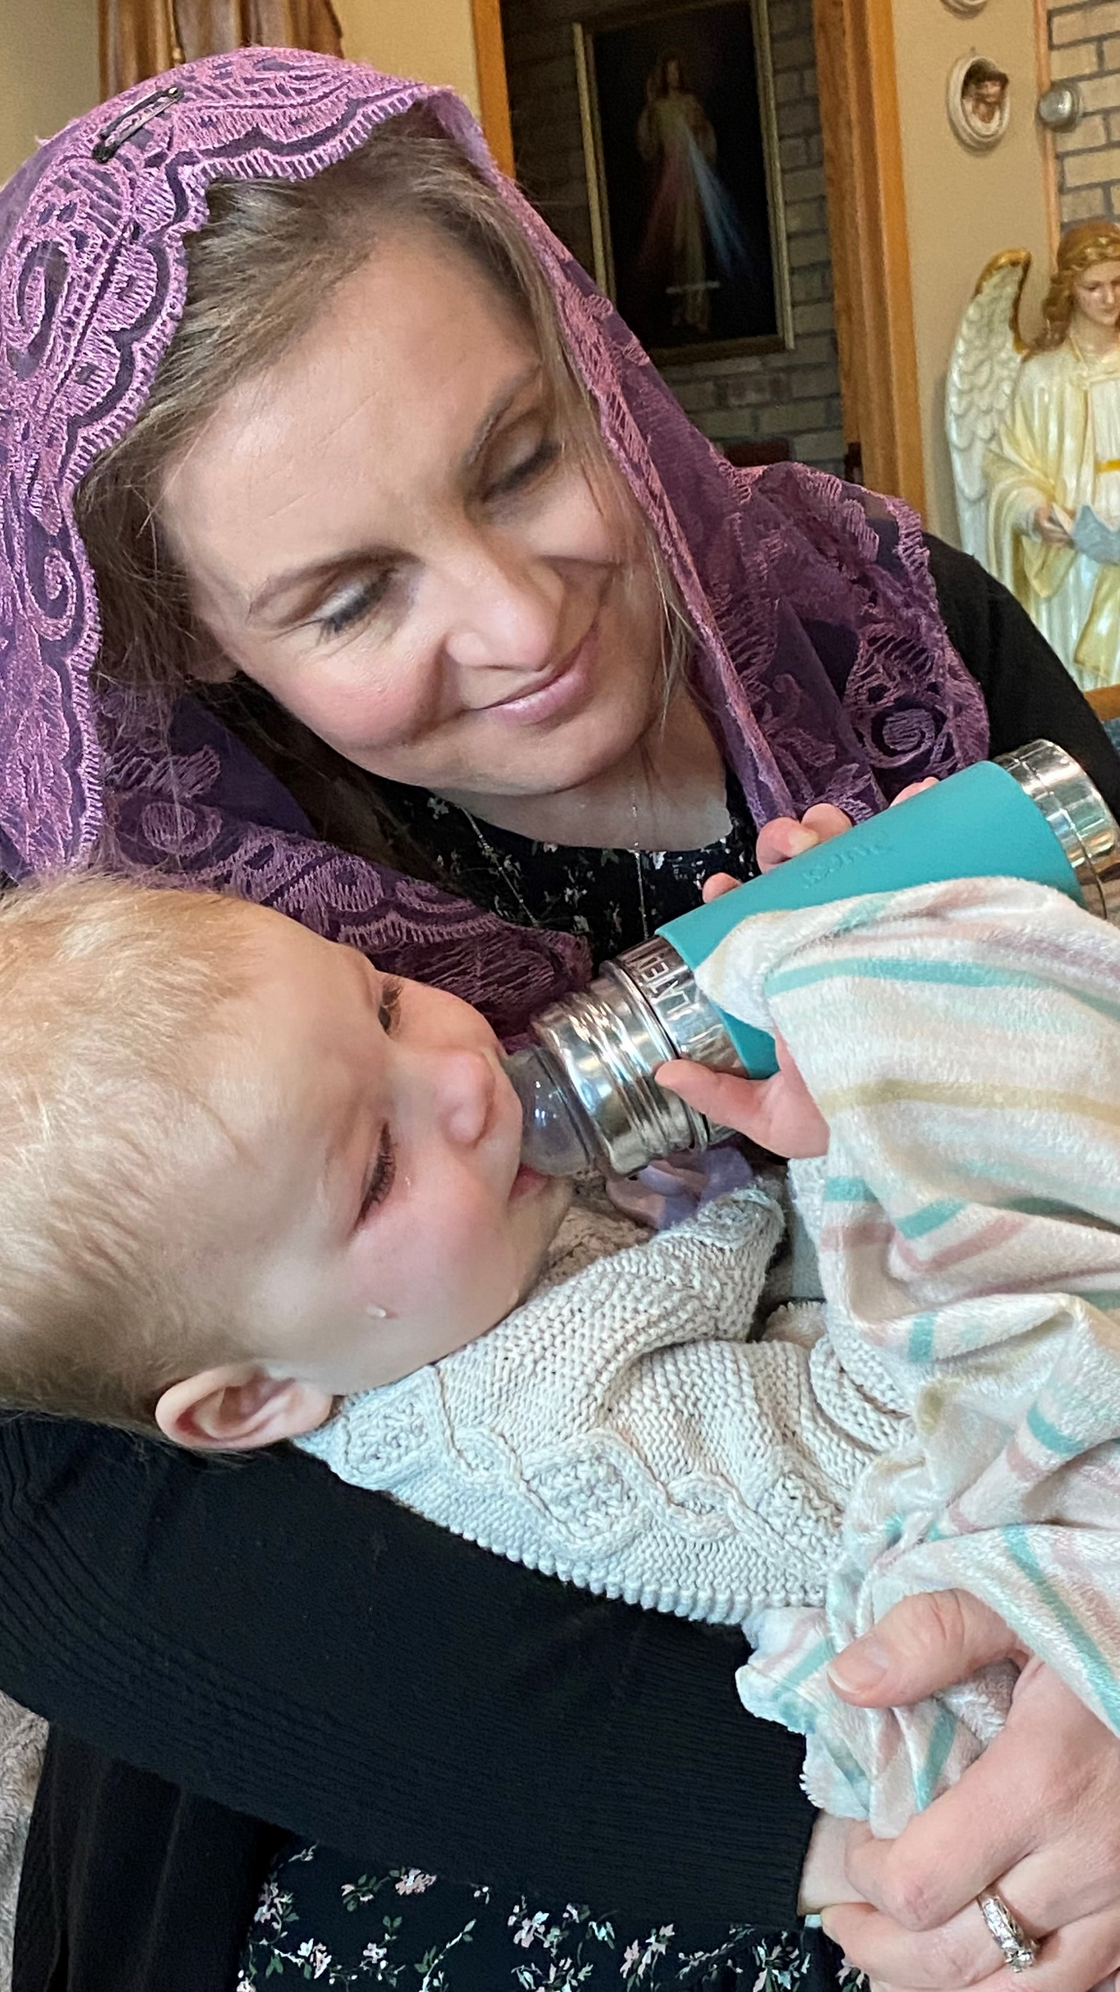
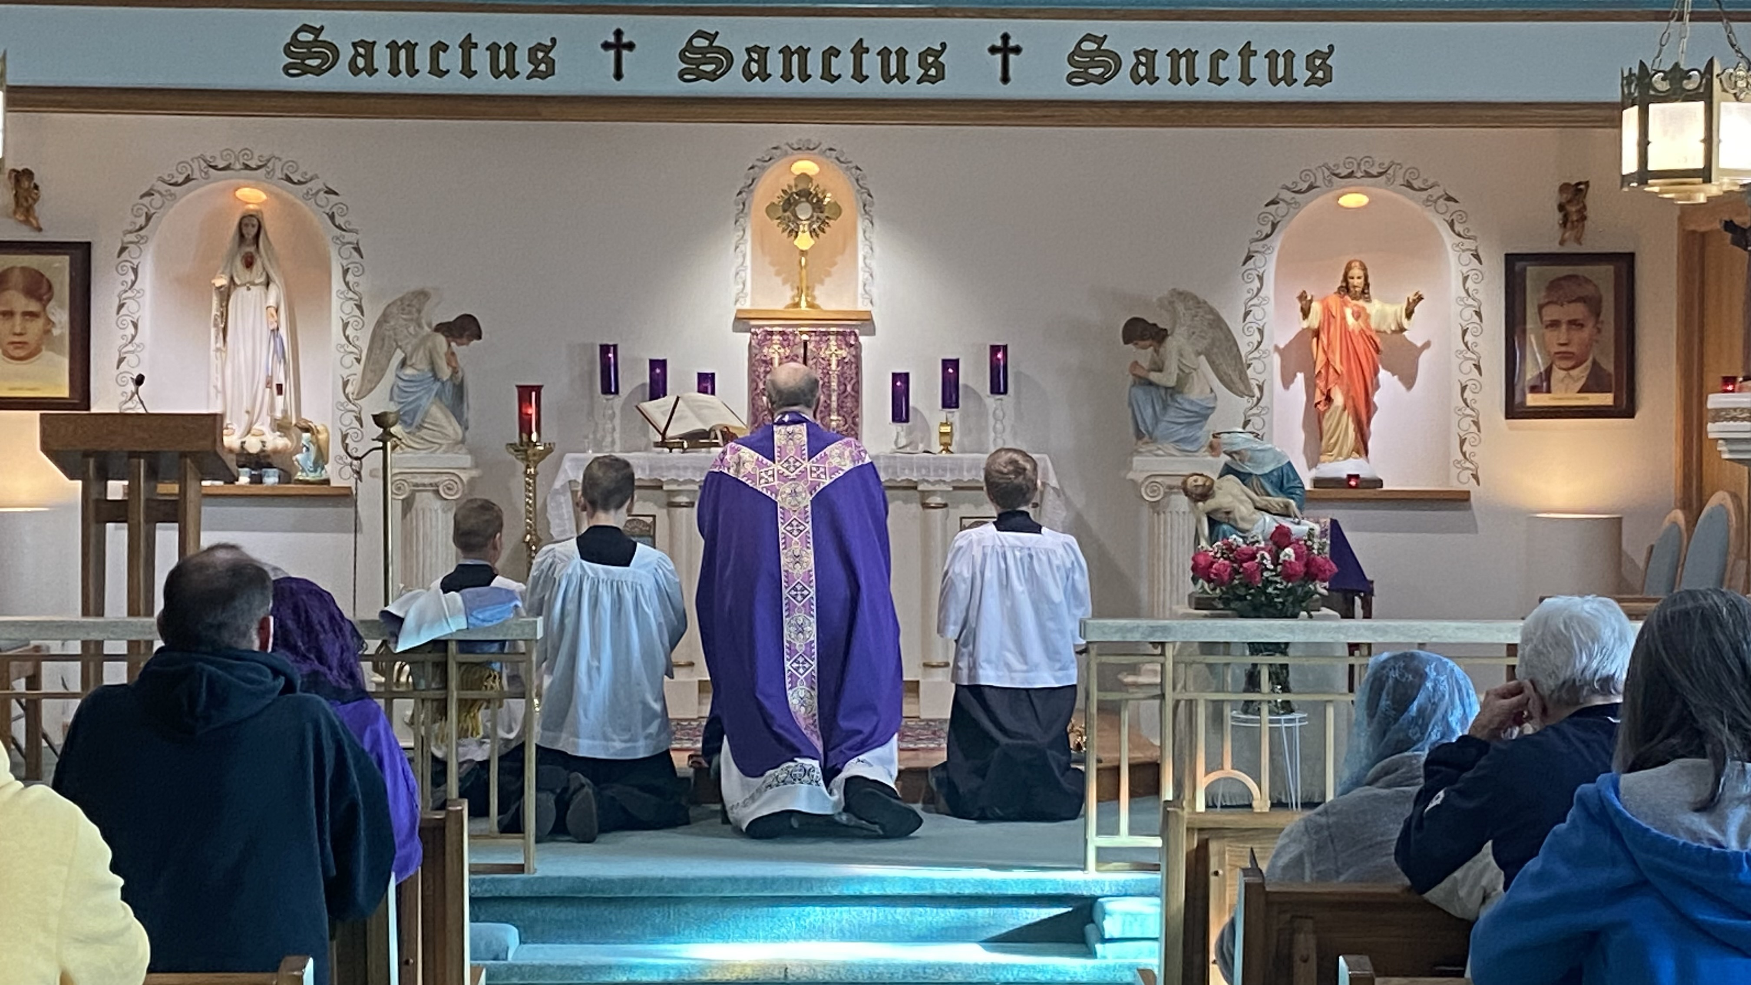
devotion to my Immaculate Heart. If people will do what I tell you, many souls will be saved and there will be peace in the world. The was is coming to an end, but if the offenses against God do not stop, another and worse one will begin in the reign of Pius XI. When you see a night illuminated by an unknown light, know that it is the great sign that God gives you that he is going to punish the world for its crimes by means of war, of hunger and of persecution of the Church and of the Holy Father.”
“To prevent this, I shall come back to ask the consecration of Russia to my Immaculate Heart and the Communion of Reparation on the First Saturdays. If my requests are granted, Russia will be converted and there will be peace. If not, she will scatter her error throughout the world, provoking wars, and persecutions of the Church. The good will be martyred; the Holy Father will have much to suffer; various nations will be annihilated, but in the end, my Immaculate Heart will triumph. The Holy Father will consecrate Russia to me; it will be converted, and a certain period of peace will be granted to the world.” “In Portugal, the dogma of the faith will be kept always.”
The Message of July 13 also contained the famous “third secret” which was, in part, revealed in 2000. It would be Our Lady of Akita, on October 13, 1973, who would ‘fill in the blanks’ following the words: “In Portugal the dogma of faith will be kept always”…..by telling us through Sister Agnes Sasagawa, “that the great apostacy from the faith will begin at the highest levels of the ecclesiastical authority.”
The lessons are many in the July 13 apparition: Hell and Satan are very real and aggressively seeking souls to destroy them; devotion to the Immaculate Heart of Mary is the sole hope for the conversion of sinners and the salvation of souls; the warning of future sufferings were fulfilled with the Second World War and the spread of atheistic Communism; and more future sufferings are coming (World War III) as the world degenerates spiritually and morally, and moves farther away from God.
Accept Our Lady of Fatima’s invitation to return every month on the thirteenth day until October. Meditate on her messages and take them seriously by living them. Pray the Rosary every day. Pray for the conversion of poor sinners by reciting, from the heart, another prayer taught to the children by Our Lady;
“O my Jesus, forgive us our sins, save us from the fires of hell, lead all souls to heaven, especially those most in need of Your mercy.”
God Love You, Father John
18637 Ray Street, Riverview, MI 48193 bluearmy18637@gmail.com
734.281.1445 1st Quarter, February 2023

Slide 4
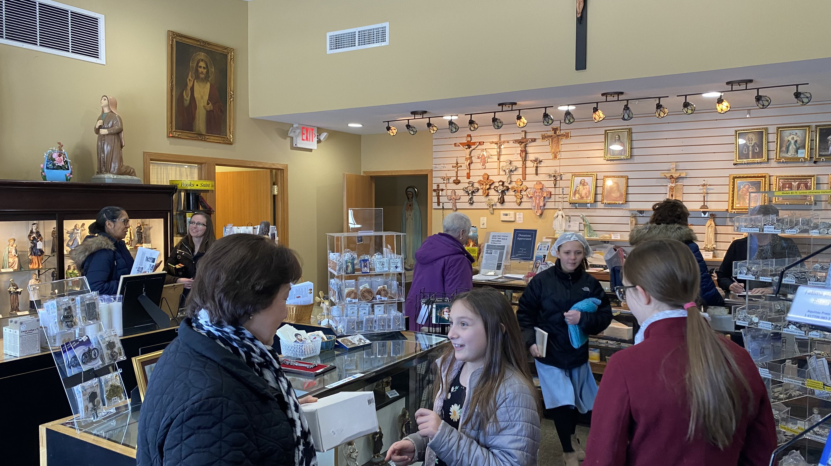
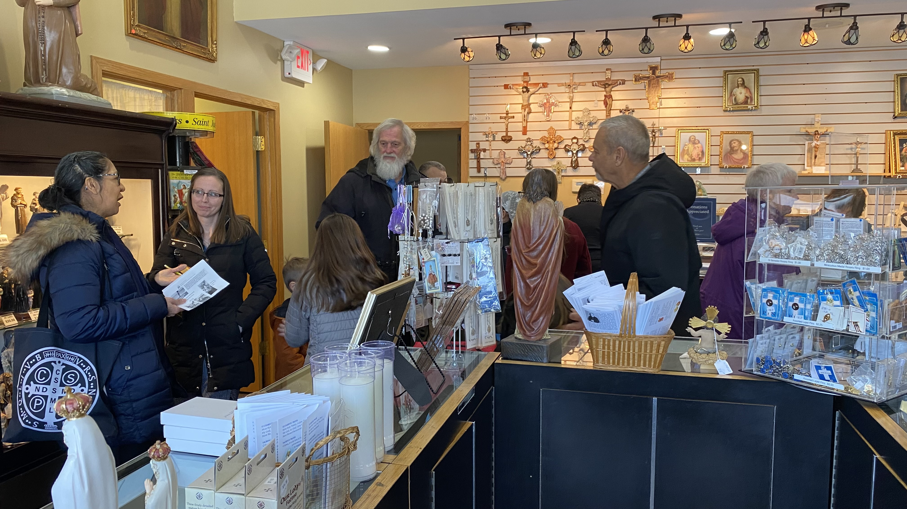
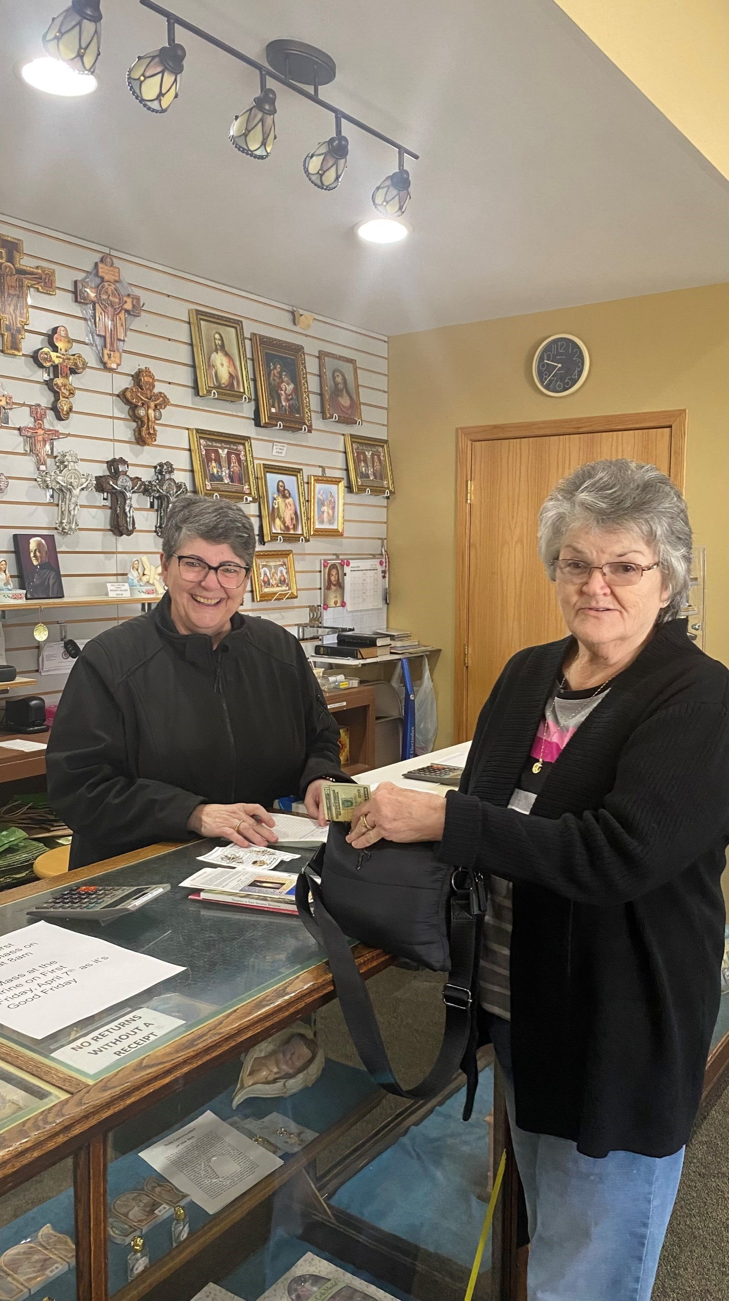
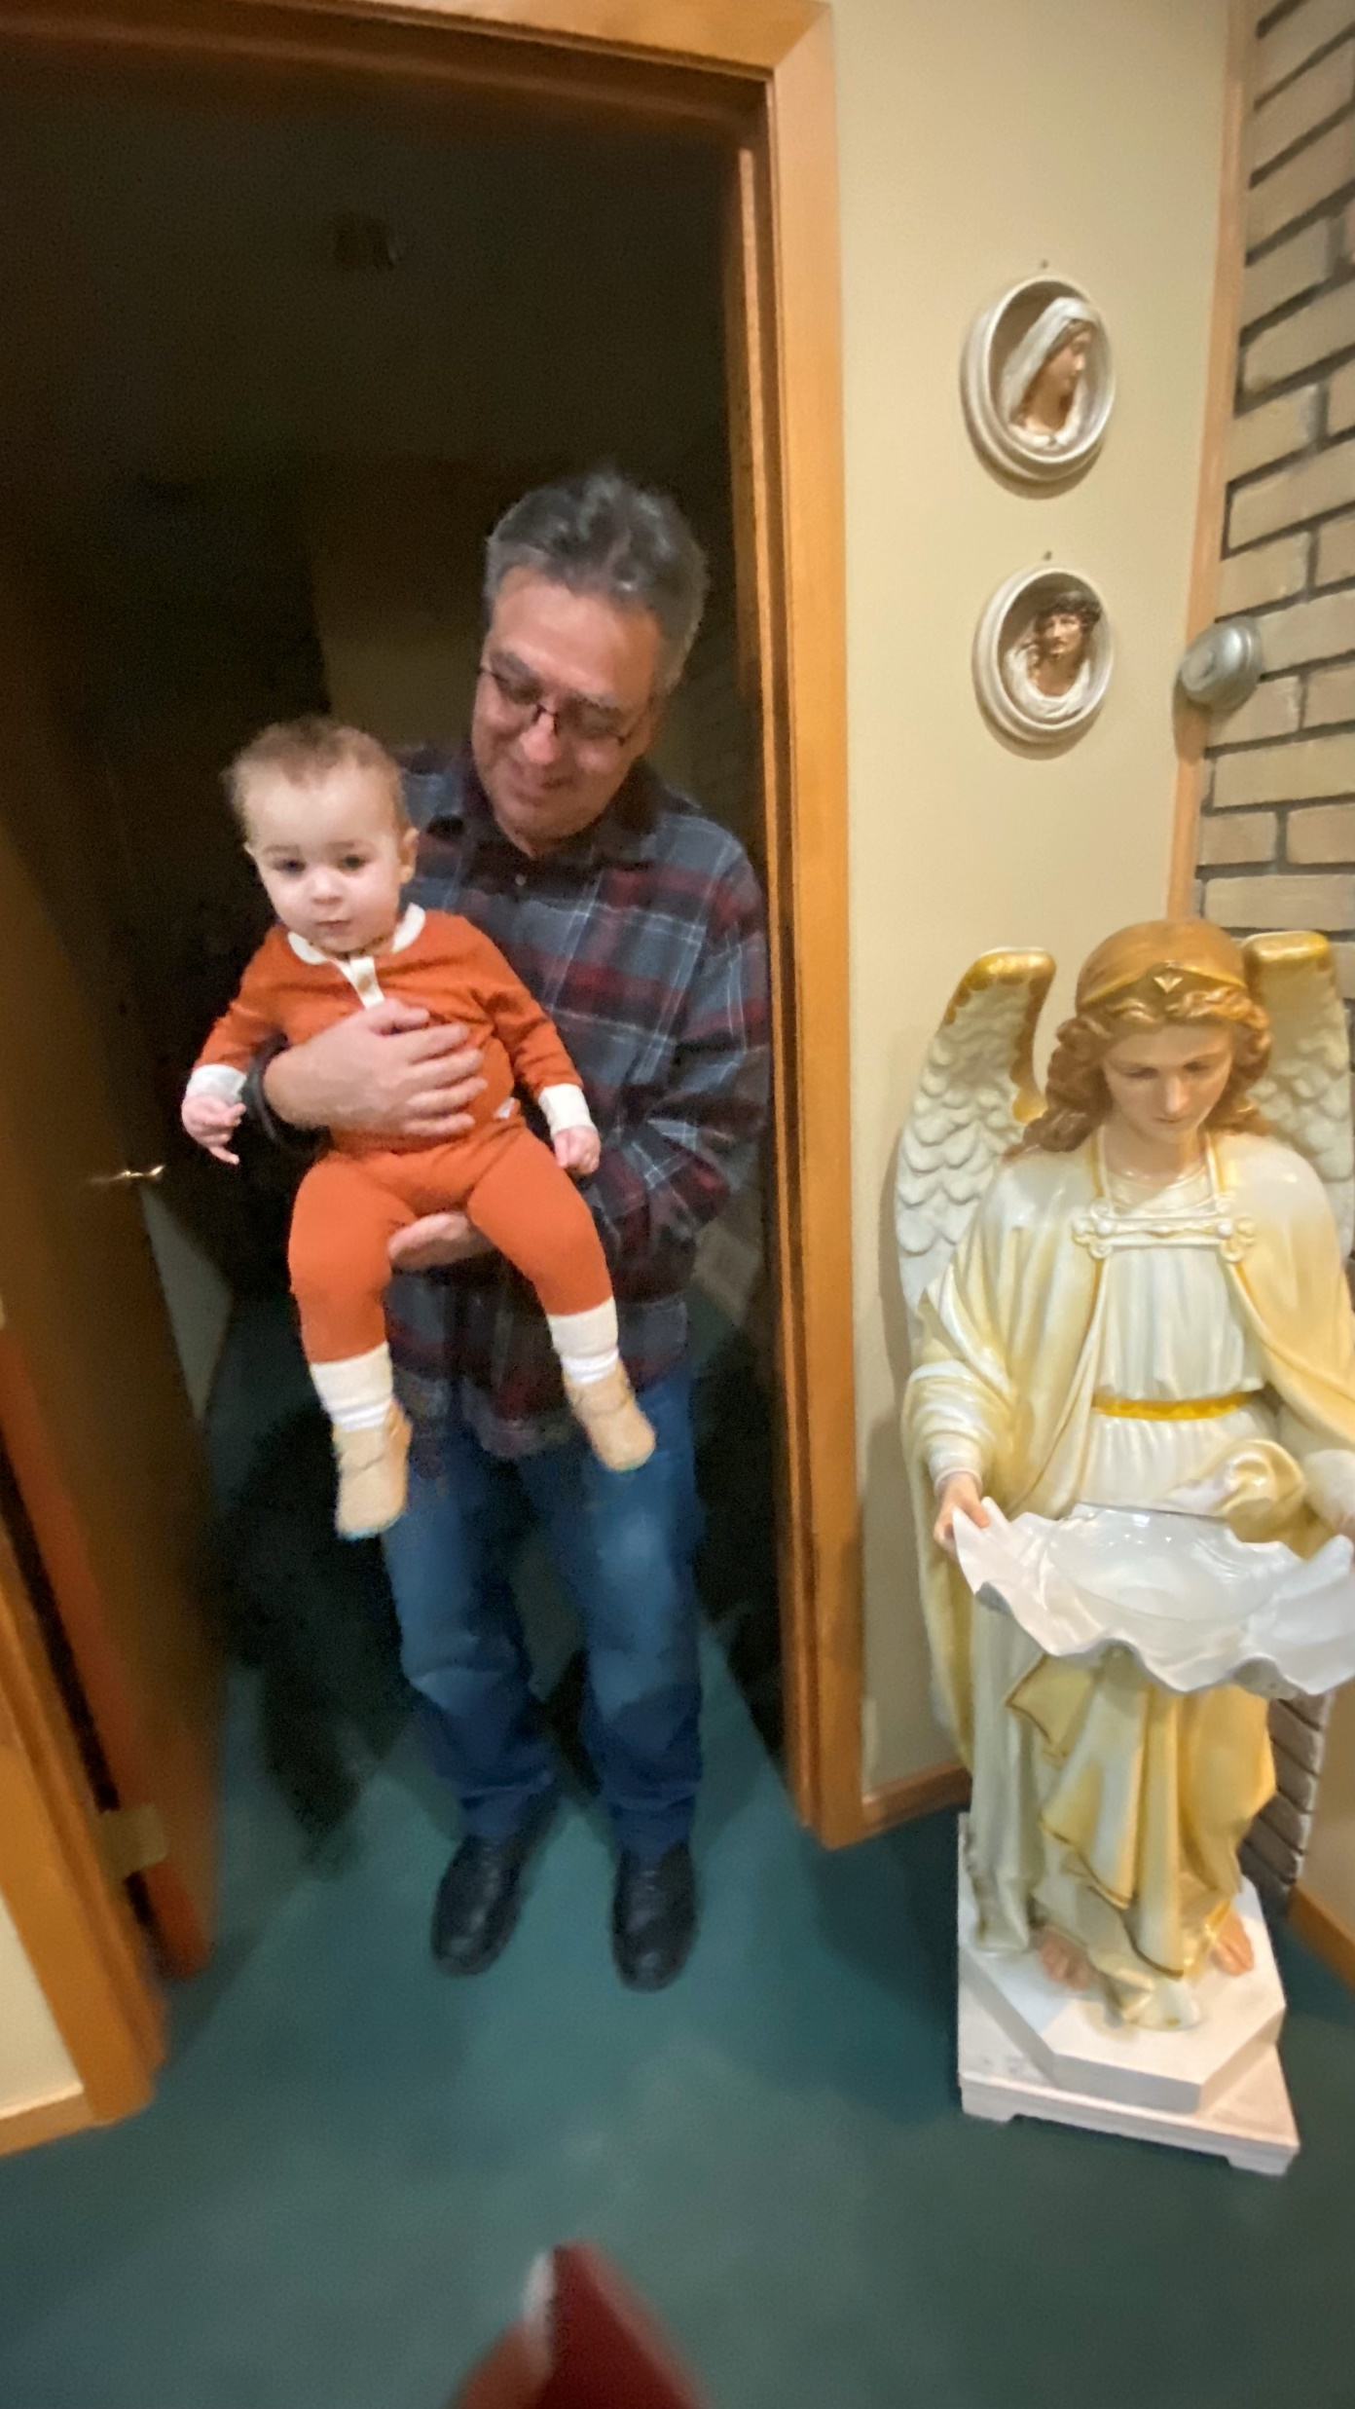
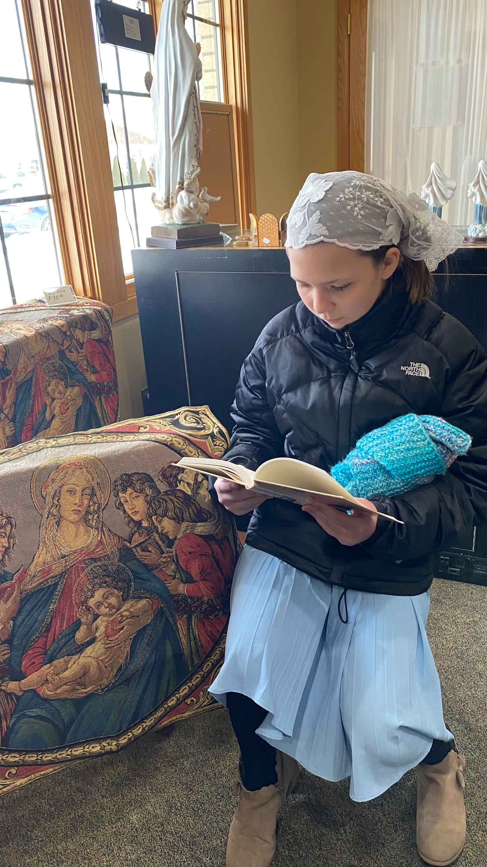
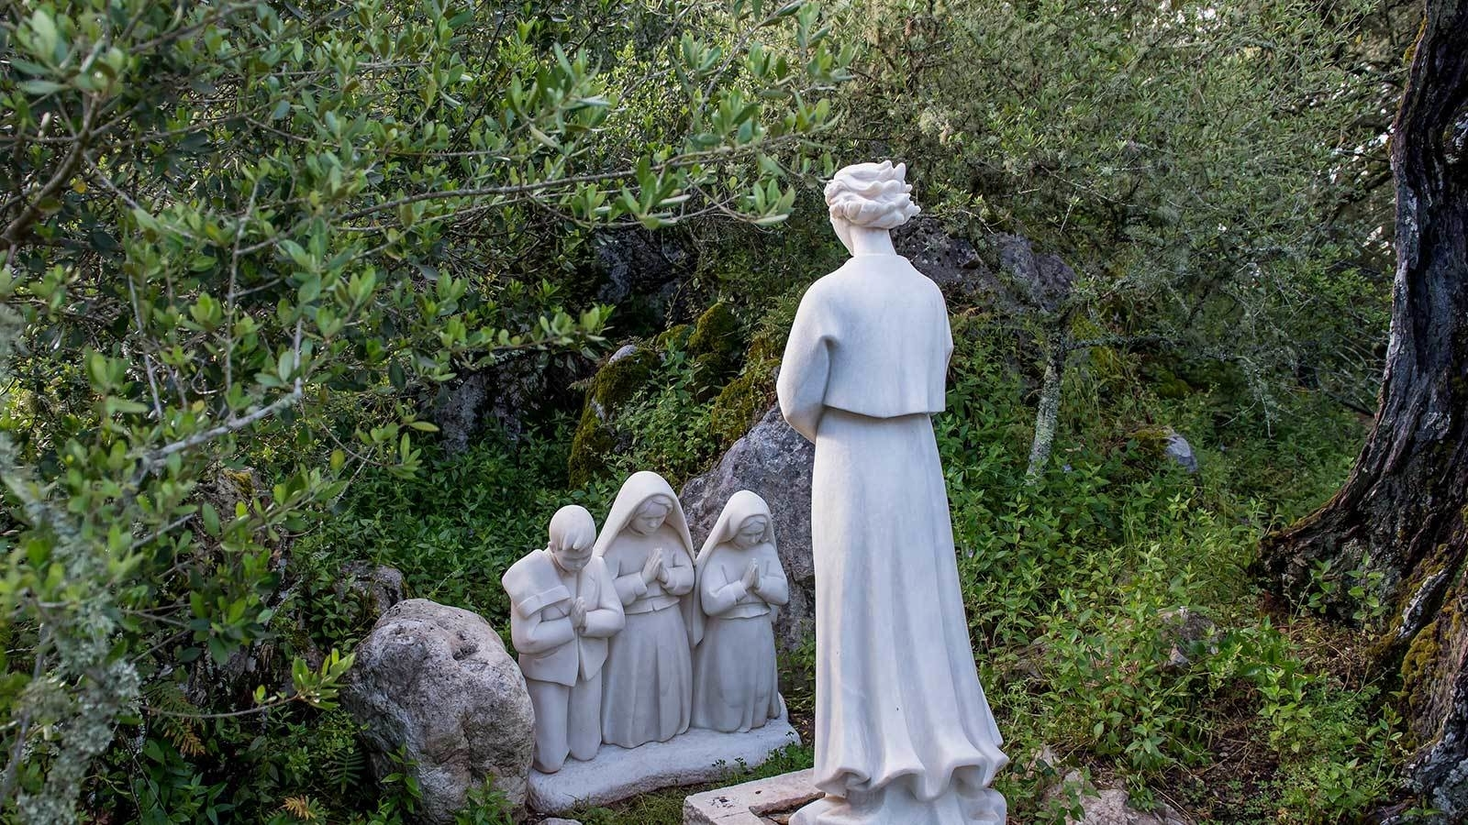
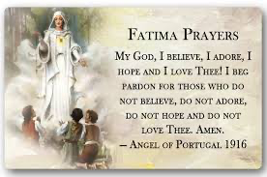
18637 Ray Street, Riverview, MI 48193 bluearmy18637@gmail.com
734.281.1445 1st Quarter, February 2023

